Slide 1
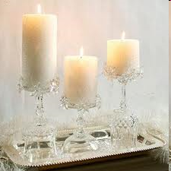
WELCOME TO OUR CLASS
Thanks for your attention!
Good Bye!

Slide 2
Miming game

Slide 3
Unit 17
What toys do you like?
Lesson 1 parts 1,2 and 3

Slide 4
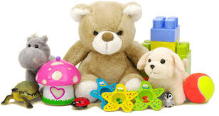
toys

Slide 5
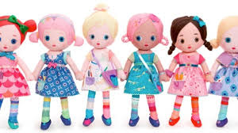
dolls

Slide 6
planes

Slide 7
toys
/z/
dolls
planes

Slide 8
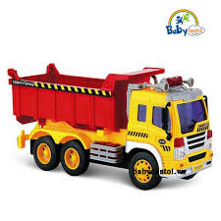
trucks

Slide 9
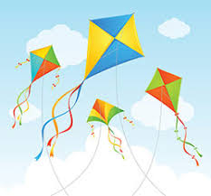
kites

Slide 10
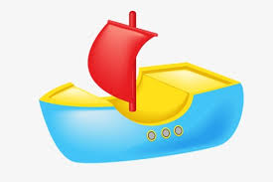
ships

Slide 11
trucks
/s/
kites
ships

Slide 12
ships
planes
kites
dolls
trucks
toys

Slide 13
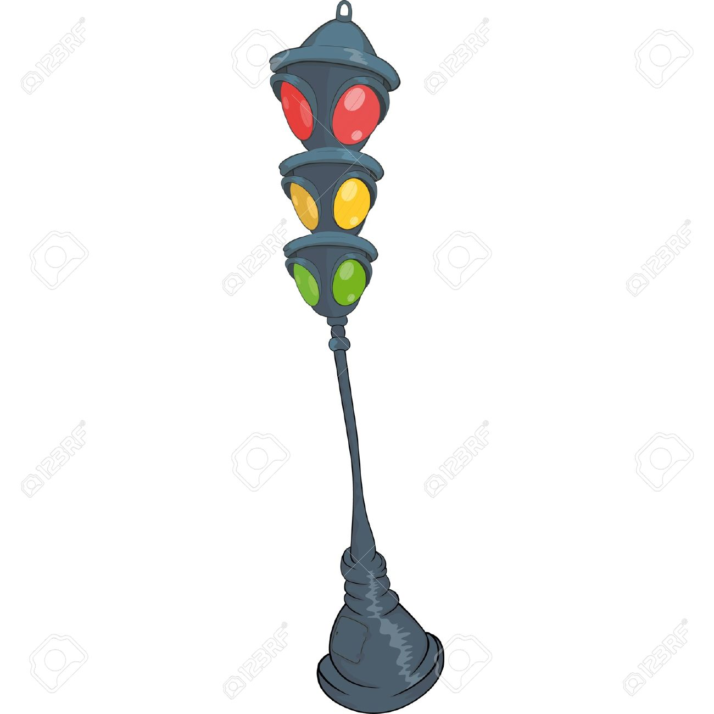
Play game
The Bus

Slide 14
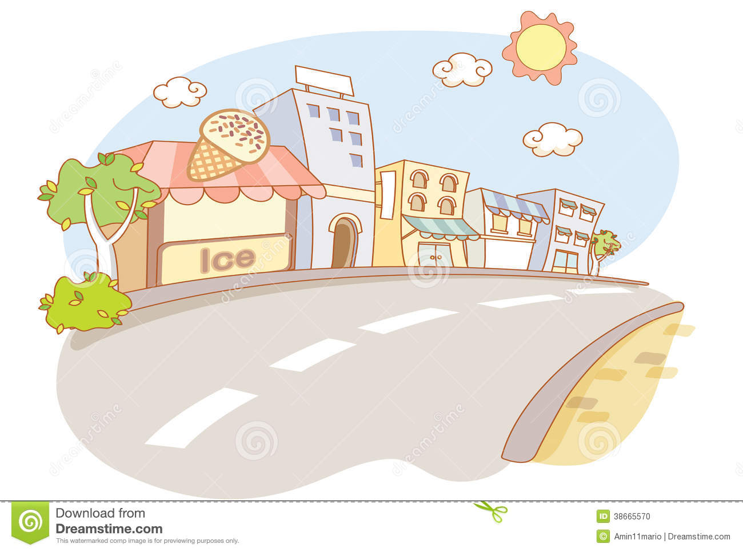
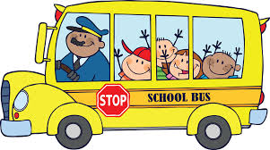
Trucks

Slide 15
Kites

Slide 16
Planes

Slide 17
Dolls

Slide 18
Toys

Slide 19
`
Teddy bears

Slide 20
1. Look, listen and repeat

Slide 21
Pair work

Slide 22
Write Yes or No
1. Nam doesn’t like toys.
Yes
No
Answer

Slide 23
Write Yes or No
2. Nam likes ships.
Yes
No
Answer

Slide 24
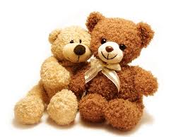
Ask and answer questions about toys
I like___________.
teddy bears
ships
What toys do you like ?

Slide 25
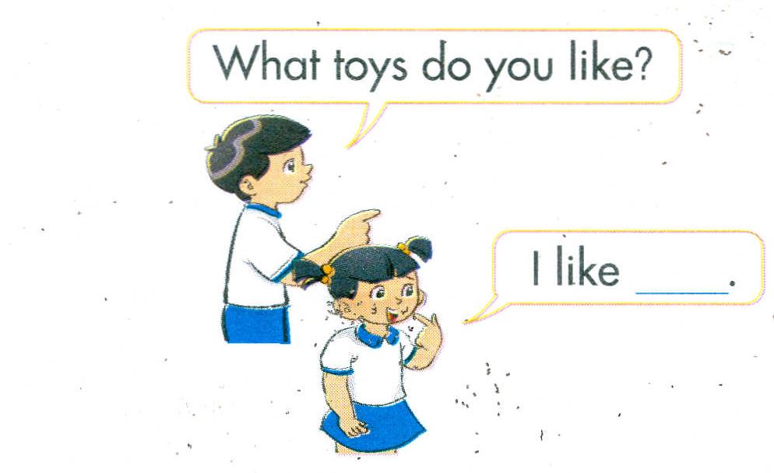
2. Point and say
a
b
trucks
dolls
d
c

Slide 26
Practise in pair

Slide 27
a
trucks

Slide 28
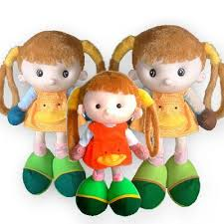
b

Slide 29
c

Slide 30
d

Slide 31
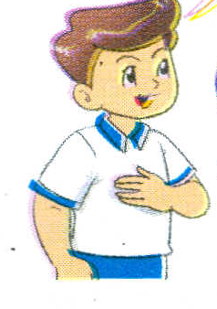
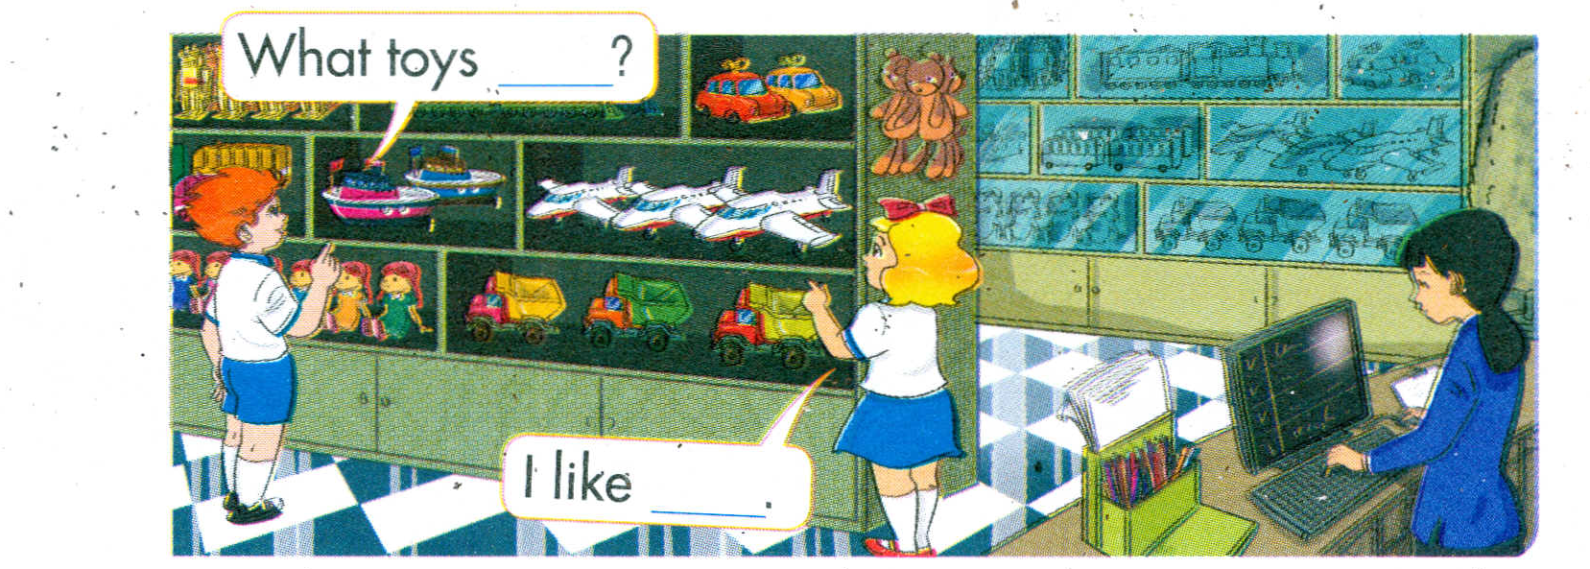
3.Let’s talk

Slide 32
Group work

Slide 33
Unit 17
toys những cái đồ chơi
dolls những con búp bê
planes những chiếc máy bay
ships những chiếc tàu
trucks những chiếc xe tải
kites những con diều
What toys do you like? Bạn thích đồ chơi gì?
I like ships. Tớ thích những chiếc tàu.

Slide 34
Thank you very much
Good bye! See you again!

